Slide 1
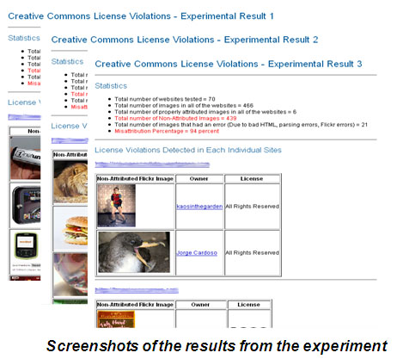
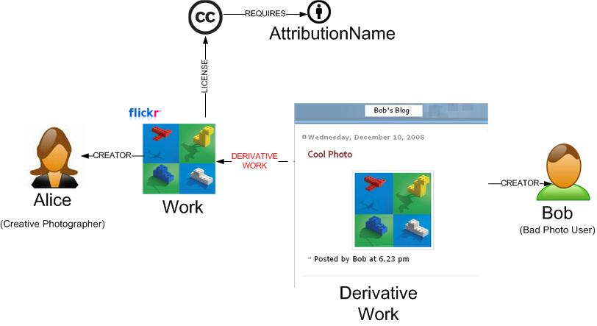
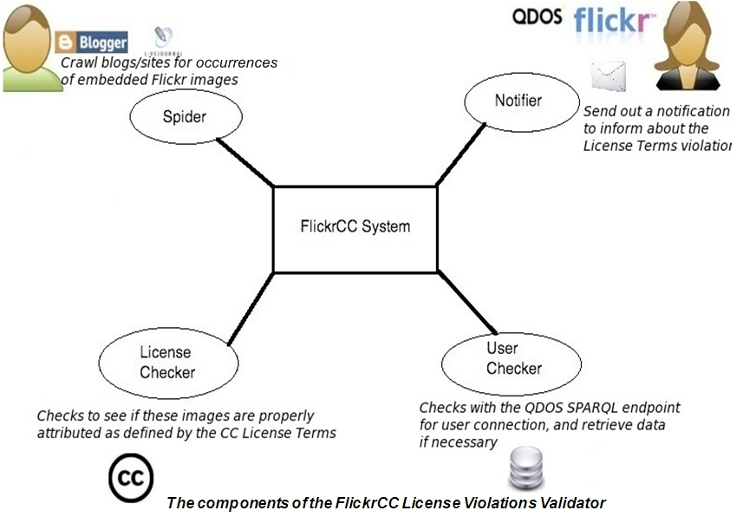
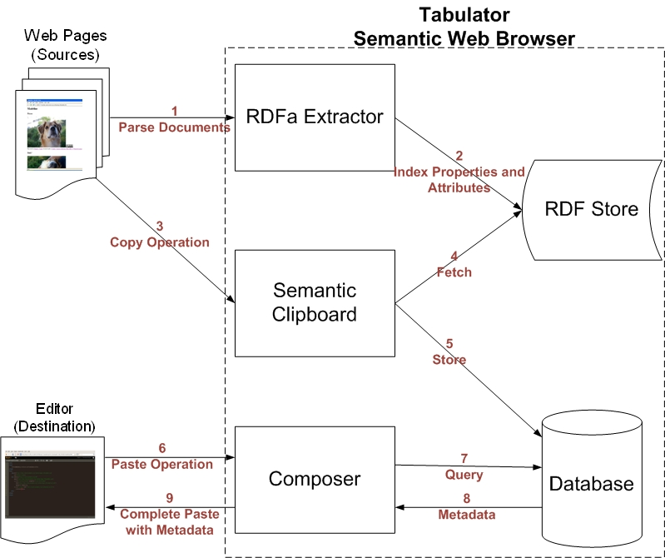
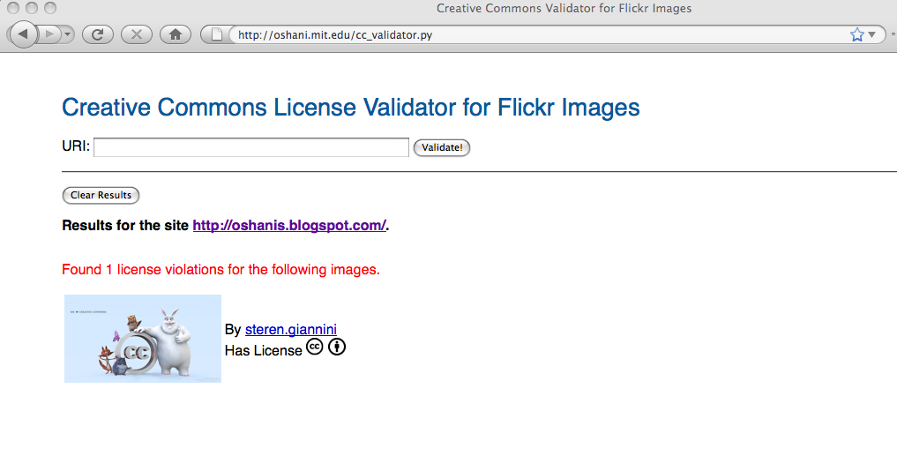
Policy Aware Content Reuse on the Web
Oshani Seneviratne
Decentralized Information Group, MIT
The Problem
The Solution
Reusing content saves resources and fosters creativity. However, reusing a particular piece of content without honoring the license expressed with it may violate the original content creator’s rights. There are several reasons this situation might happen. The person reusing the content may be:
too lazy to check for the licenses hidden in the XHTML
weary of the multi-step operations required to embed the license metadata
ignorant as to what each of the licenses mean
At the same time, the original content creator would also be interested in knowing whether someone has violated his or her license terms.
Build Policy Aware Systems, such as:
Validators to tell users what information is missing or inaccurate
Seamlessly integrate metadata by detecting and assisting in embedding the licenses
Notify users if their content is used in an inappropriate manner
Background
How can you Extract License Metadata?
Policies are pervasive in web applications as they play a crucial role in enhancing security, privacy and usability of services offered on the Web. Use of Creative Commons licenses is the widely accepted method of expressing rights of the original content creators when it comes to digital multimedia content on the Web.
The DRM alternative is often too prohibitive, and has a central point of failure from a policy perspective. Therefore rather than applying an enforcement model, the focus is on building a framework based on open standards and protocols which enables users to reuse content in a policy aware manner very easily.
1. Through APIs which expose the licenses. E.g. Flickr
2. Through RDFa (Resource Description Framework in Attributes)
A simple scenario which illustrates a rights violation of a content creator:
How much of a problem is this?
Flickr has over 100 million Creative Commons Licensed images. Given a sample of web pages which embed such images, how many of these are properly attributed as specified in their licenses?
A simple experiment was conducted to get an assessment on this, and the results are as follows:
Sample 1 (67 sites, 426 images) | Properly attributed images = 28 Misattributed images = 333 Misattribution = 78 %
Sample 2 (70 sites, 241 images) | Properly attributed images = 8 Misattributed images = 194 Misattribution = 80 %
Sample 3 (70 sites, 466 images) | Properly attributed images = 6 Misattributed images = 439 Misattribution = 94 %
Results of the experiment summarized
More Information
http://creativecommons.org
http://rdfa.info
FlickrCC Attribution License Violations Validator
A bad case of content reuse
Semantic Clipboard
Goal
Architecture of the Semantic Clipboard and the Interactions between each of the modules
Check whether a particular site has any embedded Flickr images which are not properly attributed as specified in the Creative Commons license.
Goal
Components
Enable transfer of content between Web applications with minimal effort in a policy aware manner, i.e. when content is copied, license metadata is also copied and pasted appropriately in the target application.
Spider: This is a site crawler which searches for all the links in a given seed site using a Breadth First search algorithm to determine any embedded Flickr images.
License Checker: This extracts the photo id from the Flickr image URI. Then all the information related to the photo is obtained through the Flickr API. Based on this information, the DOM of the page is checked for the proper attribution.
Notification System: This will pretty-print and report the images with missing attributions in a Web interface. The user can then use the missing information in his or her own work to be license compliant.
User Checker (optional): This module can be used to send actual notifications to the original content creators for any violations if the system is linked to some user base.
Components
RDFa Extractor: Extracts all the semantic information in the form of RDF attributes embedded in the HTML page the user browses.
RDF Store: Indexes and stores all the RDF data from the pages that the user has visited in a given browser session.
Semantic Clipboard: Acts as the control panel to co-ordinate the copy and paste operations.
Database: This is used to make the data persistent across browser sessions.
Composer: Reasons whether the content can be used based on the source and the destination license terms. Prepares the content and the license metadata in a suitable manner in to be pasted right in to the target .
All of these components are implemented in the Tabulator, a Semantic Web Browser which can be installed as a Firefox Extension.
Semantic Clipboard can be turned on/off through a menu option. When using the application, content can be collected from a variety of sources.
A browser based editor is used to demo how an application could call the Clipboard for the content, and embed it with the license metadata or warn if the target document’s license is incompatible with the source license .
Try it out!
http://oshani.mit.edu/cc_
validator.py
More Information
http://dig.csail.mit.edu/2008/WSRI-Exchange
Try it Out!
http://dig.csail.mit.edu/2007/tab
More Information
http://dig.csail.mit.edu/2009/Clipboard
Website to Validate
Validator
License Violations Validator – Only requires the URI of the site to check for a license violation
Contributions
Policies
Content
Reuse
Future Work
Assessment on the level of policy-awareness on the Web
Provide a platform to use the data exposed on the Semantic Web
A License Violations Validator for Flickr images:
to check for license violations
use the information given by the validator to be policy-compliant
Semantic Clipboard:
to detect reusable content while browsing
seamlessly integrate such content along with their metadata
Assess the level of violations with regards to other types of licenses such as ‘no commercial use’, ‘share alike’ and ‘no derivatives’
Assess the level of license violations on other types of media
Extend to licenses embedded in free-floating content
Explore new and efficient ways of license violations detection
Improve the User Interfaces of the CC license violations validator and the Semantic Clipboard
Please send your comments to oshani@csail.mit.edu
This work by Oshani Seneviratne is licensed under Creative Commons Attribution - Non Commercial - Share Alike 3.0 license.

