Slide 1
Using PHP in Linked Data Applications
Jie Bao
Oct 12

Slide 2
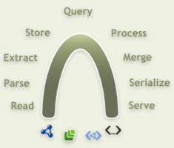
ARC2
ARC2 is PHP-based
Various RDF parsers and extractors (RDF/XML, Turtle, RSS, microformats, eRDF, RDFa, ...)
Serializers (N-Triples, RDF/JSON, RDF/XML, Turtle)
RDF Storage, SPARQL Query, and Update
http://arc.semsol.org/

Slide 3
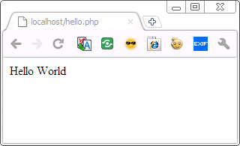
PHP Program
<?php
echo “Hello World”;
?>
Can be run in dual modes:
http://localhost/hello.php
php hello.php

Slide 4
Task today
Load Lalana’s foaf file at http://www.csail.mit.edu/~lkagal/foaf
Extract her friends
Look at the friends’ FOAF files, see where they work
Use the workplace URI or the labels to query dbpedia for it’s location
Print a list of friends, their workplaces and where the workplaces are located

Slide 5
Getting Started
<?php
include_once("./ARC2/arc/ARC2.php");
$parser = ARC2::getRDFParser();
$parser->parse('http://www.csail.mit.edu/~lkagal/foaf');
$triples = $parser->getTriples();
foreach($triples as $triple){
print_r($triple);
}
?>
1 Load Lalana’s foaf file at http://www.csail.mit.edu/~lkagal/foaf

Slide 6
Setup Local Triple Store
We will use a SPARQL query
Need to setup a local database for that (ARC2 uses MySQL)
$config = array(
'db_name' => 'arc2',
'db_user' => 'arc2',
'db_pwd' => 'arc2‘,
'store_name' => 'arc_tests'
);
$store = ARC2::getStore($config);
if (!$store->isSetUp()) {
$store->setUp();
}
$store->query(
‘LOAD < 'http://www.csail.mit.edu/~lkagal/foaf >');
2. Extract her friends

Slide 7
Do Some Query
$q = '
PREFIX foaf: <http://xmlns.com/foaf/0.1/> .
SELECT ?person ?name WHERE {
<http://people.csail.mit.edu/lkagal/foaf#me> foaf:knows ?person .
?person foaf:name ?name .
}
';
echo "<table>";
if ($rows = $store->query($q, 'rows')) {
foreach ($rows as $row) {
$foafURL = $row['person'];
echo '<li>' . $row['name'] . '<br/>' . $foafURL . "</li>\n“;
}
}
3. Look at the friends’ FOAF files, see where they work

Slide 8
Do a More Complicated Query
SPARQL Endpoint:
http://dbpedia.org/sparql
PREFIX rdfs: <http://www.w3.org/2000/01/rdf-schema#>
PREFIX type: <http://dbpedia.org/class/yago/>
PREFIX prop: <http://dbpedia.org/property/>
PREFIX ont: <http://dbpedia.org/ontology/>
PREFIX foaf: <http://xmlns.com/foaf/0.1/>
PREFIX geo: <http://www.w3.org/2003/01/geo/wgs84_pos#>
SELECT DISTINCT ?label ?lat ?long WHERE {
{
{?resource prop:website <""" + workplace + """>.}
UNION
{?resource foaf:homepage <""" + workplace + """>}
}
{
{?resource ont:location ?location.
OPTIONAL {?location geo:lat ?lat.
?location geo:long ?long.}
OPTIONAL {?location rdfs:label ?label.}
}
UNION
{?subject prop:employer ?resource}
UNION
{?subject prop:institution ?resource}
UNION
{?subject prop:workInstitution ?resource}
UNION
{?subject prop:workInstitutions ?resource}
UNION
{?subject prop:workplaces ?resource}
UNION
{?subject ont:occupation ?resource}
OPTIONAL {?resource geo:lat ?lat.
?resource geo:long ?long.}
OPTIONAL {?resource rdfs:label ?label.}
}}
4. Use the workplace URI or the labels to query dbpedia for it’s location

Slide 9
Query a Remote Store
$config_dbpedia = array(
/* remote endpoint */
'remote_store_endpoint' => 'http://dbpedia.org/sparql'
);
$store_dbpedia = ARC2::getRemoteStore($config_dbpedia);
$q = '
PREFIX foaf: <http://xmlns.com/foaf/0.1/> .
SELECT ?name ?person ?workplace WHERE {
<http://people.csail.mit.edu/lkagal/foaf#me> foaf:knows ?person .
?person foaf:workplaceHomepage ?workplace .
OPTIONAL {?person foaf:name ?name }
}';
$rows = $store->query($q, 'rows')) ;
4. Use the workplace URI or the labels to query dbpedia for it’s location

Slide 10
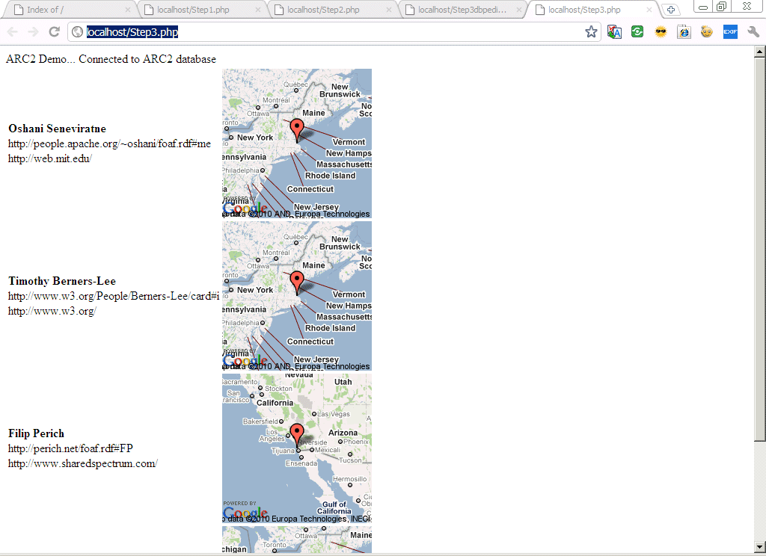
Visualize your result
5. Print a list of friends, their workplaces and where the workplaces are located

Slide 11
Demo and Questions

